Slide 1
Selfies for Silence
By the GSA
Diversity Week 2015

Slide 2
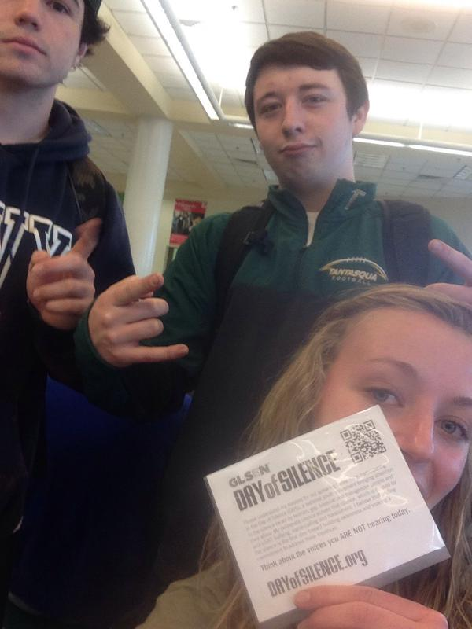
Let’s get this started

Slide 3
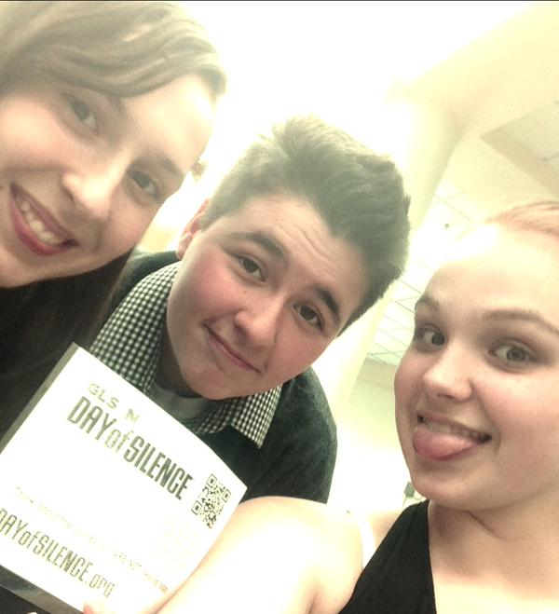
LOOK AT THESE CUTIES

Slide 4
What is the Day of Silence?
Today some of us made a promise not to talk
in honor of all those who aren’t safe
to speak freely and be who they are in their communities.

Slide 5
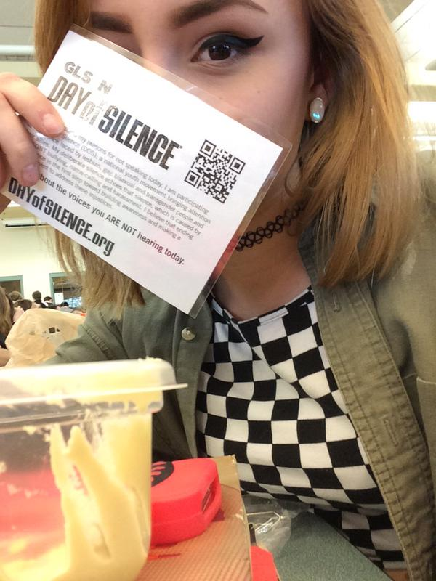
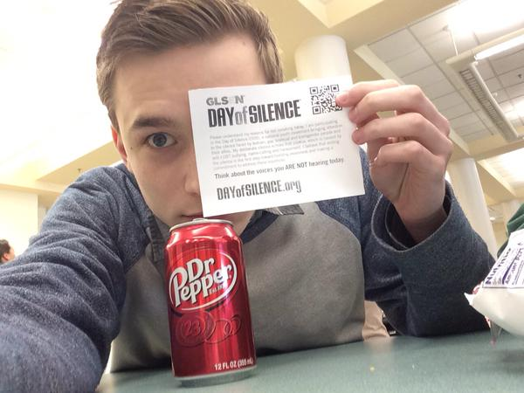
That classic cover-the-face thing everyone does

Slide 6
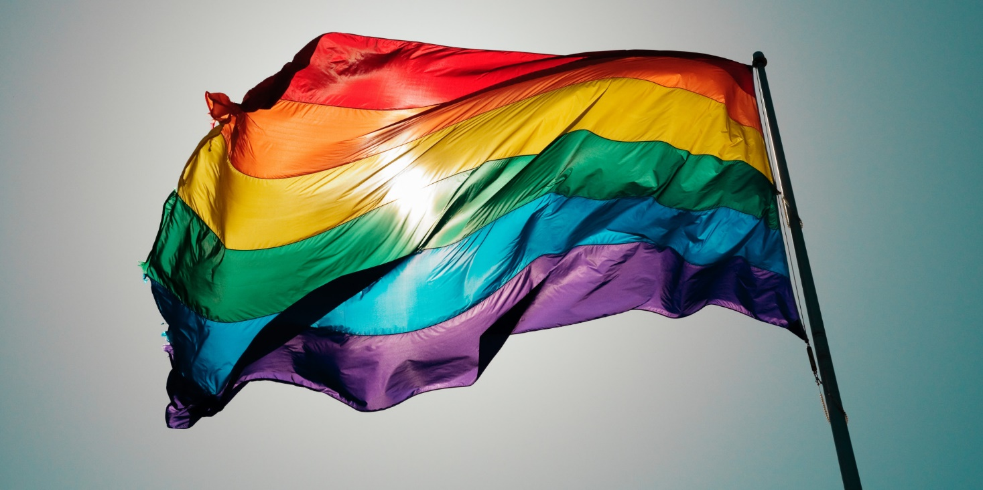
Tantasqua IS a pretty great school…
But some kids don’t get the same freedom
to be comfortable in their sexuality that we have here.

Slide 7
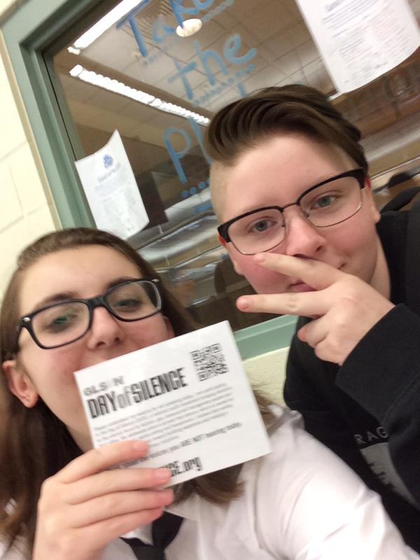
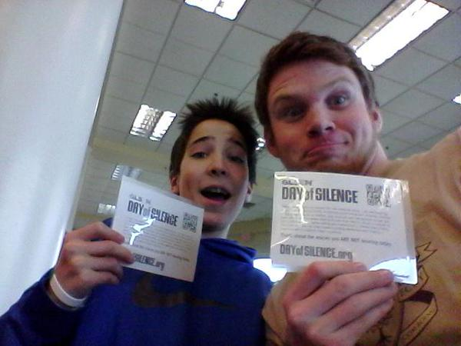
Help.

Slide 8
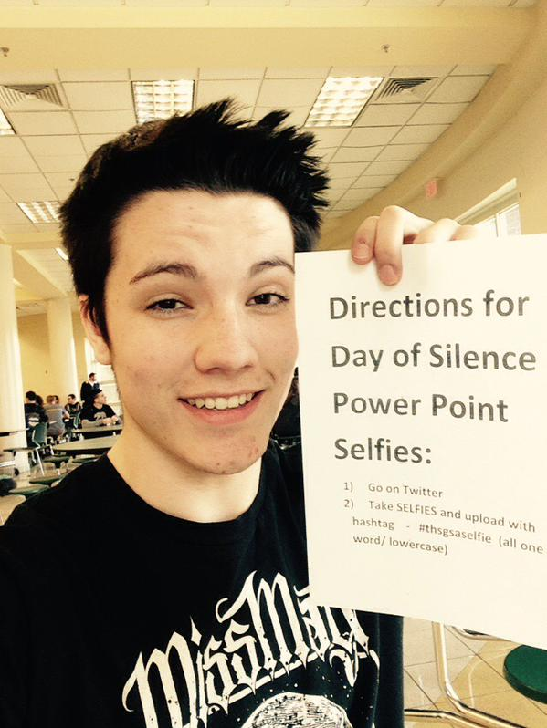
This one is our favorite!
He took a picture with the directions..
Love it.

Slide 9
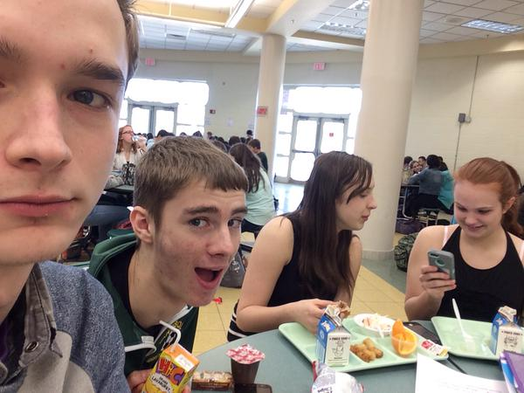
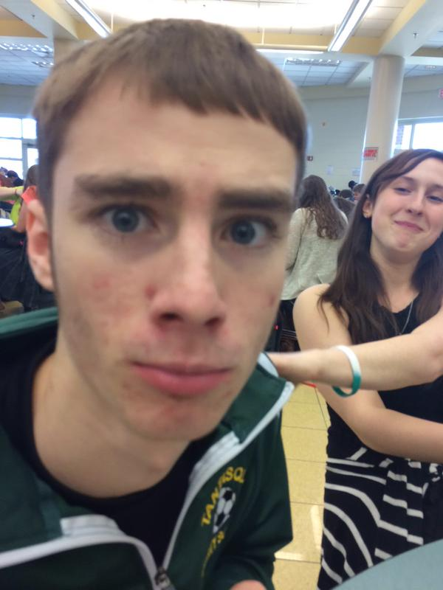
Unsuspecting Selfie victims…

Slide 10
Some people…
Still have a habit of using derogatory terms and hateful words that make some people feel unsafe.
I think we all know what those words are.

Slide 11
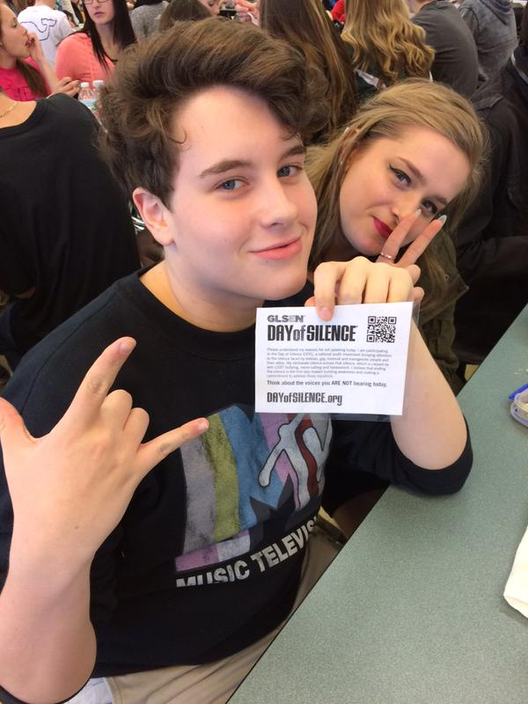
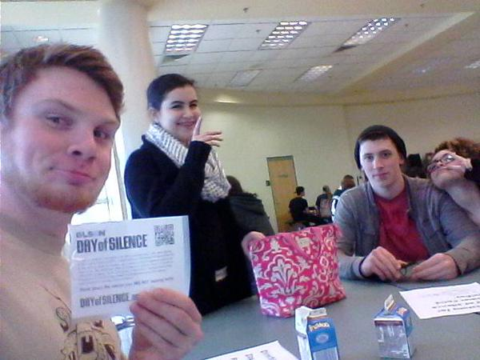
Peace signs everywhere

Slide 12
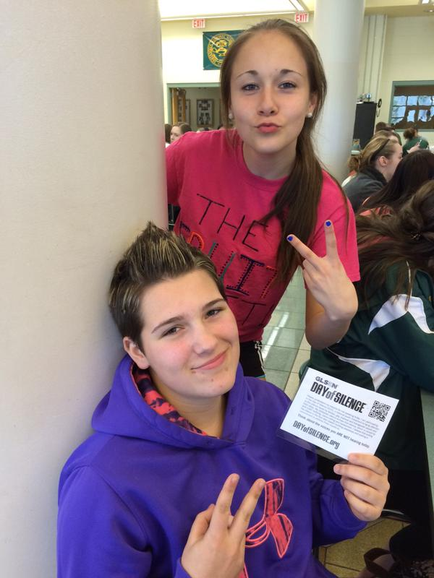
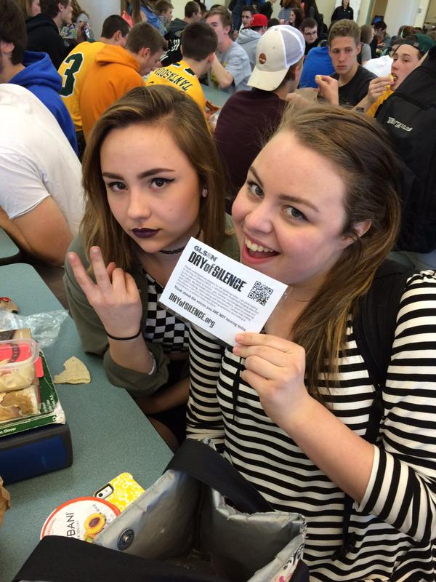
MORE PEACE SIGNS

Slide 13
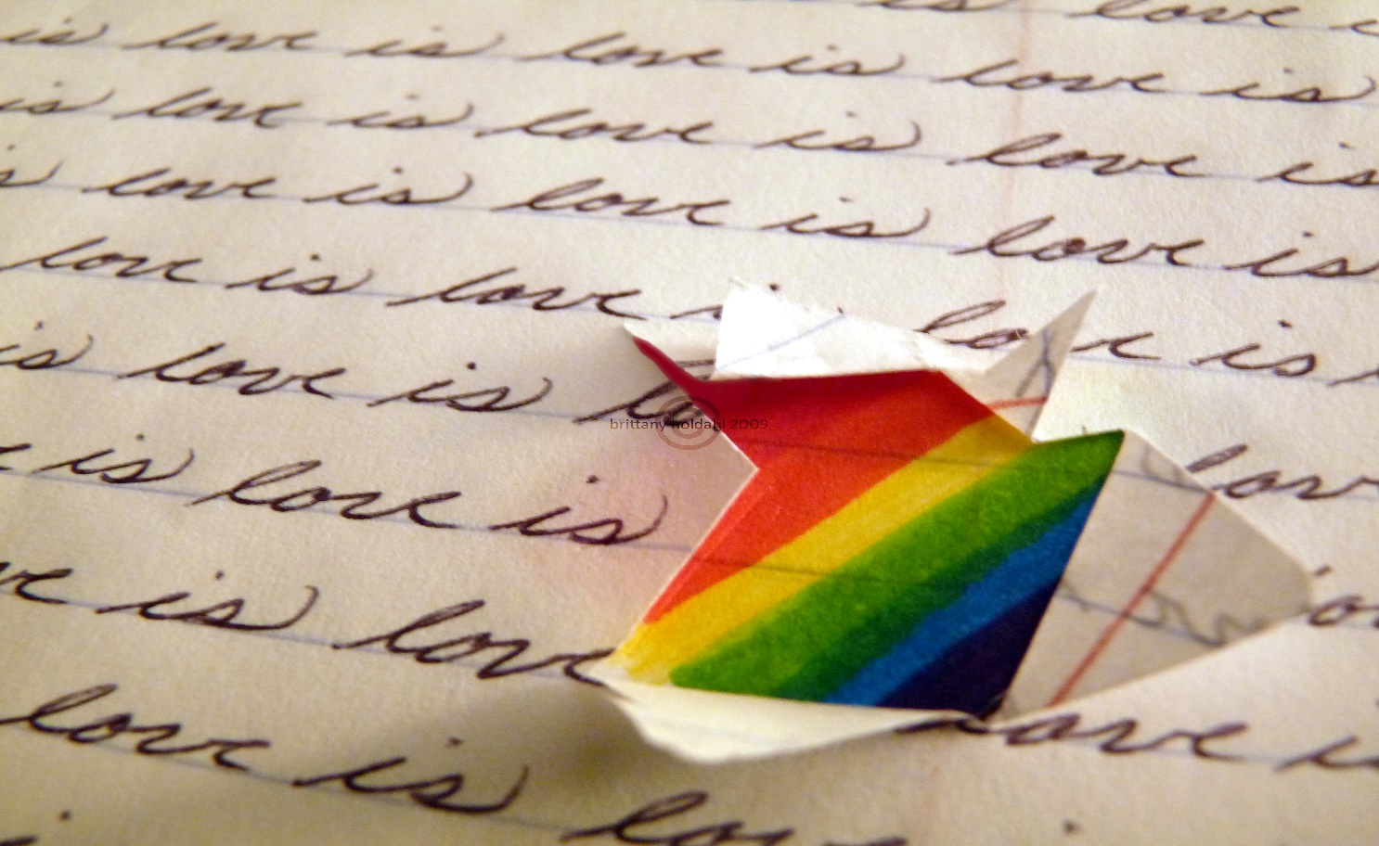
Remember Our Advisory?
Everyone has the right to be who they are.
Diversity week has been a way to remind us all of that.

Slide 14
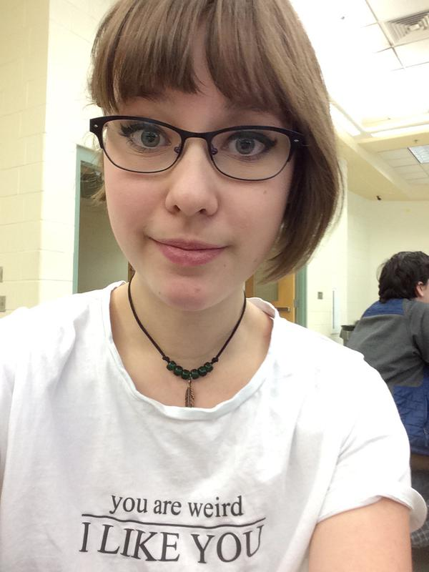
I like you too Sadie.
And your shirt.

Slide 15
Today our silence is in honor of all the kids who can’t speak for themselves.
To let them know they aren’t alone.

Slide 16
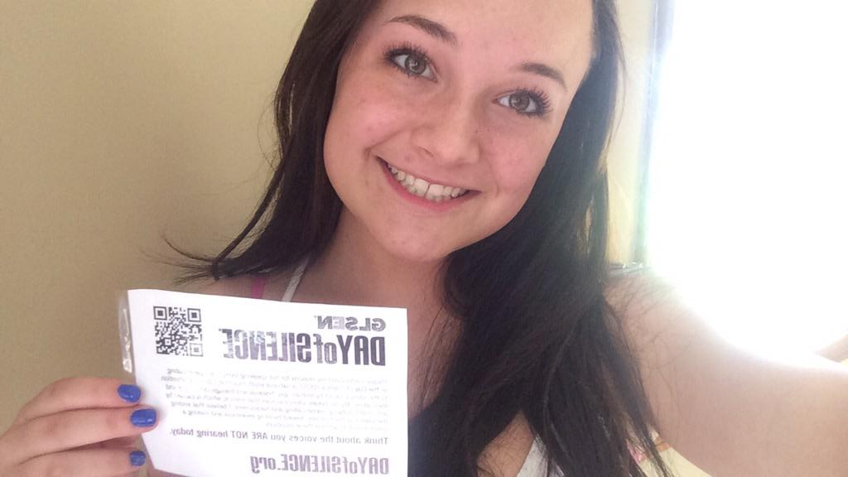
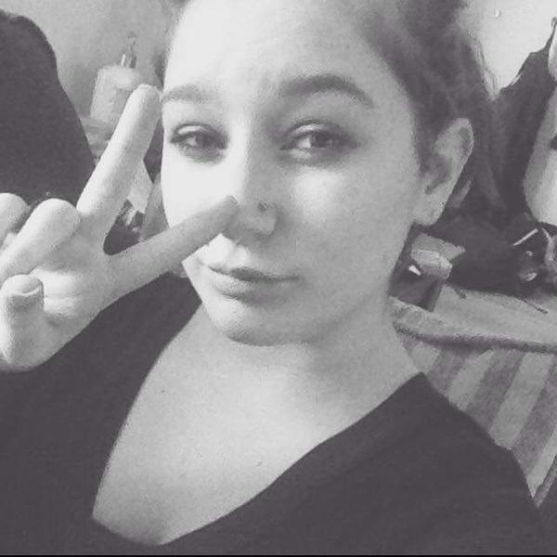

Slide 17
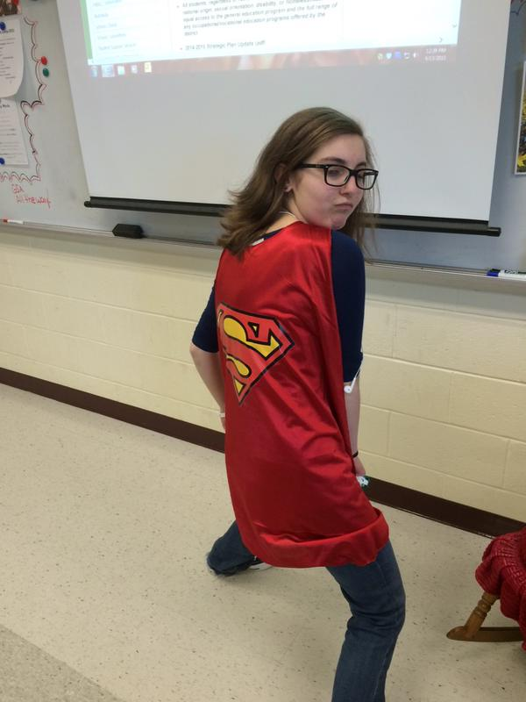
S.O.S.

Slide 18
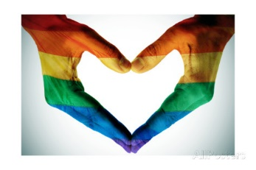
Show your support by buying a GSA bracelet,
Or joining the Gay-Straight Alliance!
Thanks to the 25 kids who took pictures……

